Slide 1


Project on Quora Question Pair Similarity
Team Name : Code_Mates
Team Manager
Team Members
Mani Teja
Potnuru Jayanth
Kanuri Veeresh
Toram Murugesh
Aditi Jaykumar Rokade
Naman Arora
Mrudula A P

Slide 2
TABLE OF CONTENTS
Introduction
Problem Statement and Objective
Type of Machine Learning Problem
About Dataset
Exploratory Data Analysis
Data Pre-Processing
Feature Extraction
Text to Numerical Vector Conversion
Model Building
Model Evaluation
Experiment Tracking using MLFlow
Conclusion
Future Scope

Slide 3
INTRODUCTION
About Quora :
Quora is a social question-and-answer platform to ask questions and connect with people who contribute unique insights and quality answers. Users can collaborate by editing questions and commenting on answers that have been submitted by other users.
One of the major problems that Quora face is the duplication of questions. Duplication of question ruins the experience for both the questioner and the answerer. Multiple questions with the same intent can cause seekers to spend more time finding the best answer to their question, and make writers feel they need to answer multiple versions of the same question.

Slide 4
Problem Statement :
To identify which questions asked on Quora are duplicates of questions that have already been asked.
This will be useful to instantly provide answers to questions that have already been answered.
We are supposed to predict whether a pair of questions are duplicates or not.
Objective :
The goal of this project is to predict which of the provided pairs of questions contain two questions with the same meaning.

Slide 5
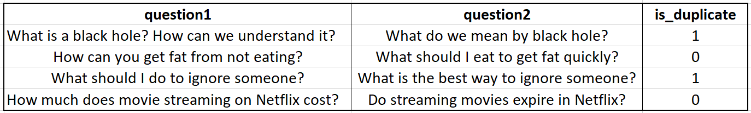
Type of Machine Learning Problem :
Binary classification problem
For a given pair of questions we need to predict if they are duplicate or not.

Slide 6
About Dataset :
The given dataset "Train.csv" contains 404,290 rows and 6 columns
Data fields :
id - the id of a training set question pair
qid1, qid2 - unique ids of each question (only available in train.csv)
question1, question2 - the full text of each question.
is_duplicate - is the dependent variable, and the target variable is set to 1 if question1 and question2 have essentially the same meaning, and 0 otherwise.

Slide 7
Exploratory Data Analysis
EDA is applied to investigate the data and summarize the key insights
Gives the basic understanding of your data, it’s distribution, null values and much more.
Type of analysis:
Non Graphical Analysis
Univariate analysis:
This type of data consists of only one variable.
The main purpose of the analysis is to describe the data and find patterns that exist within it.
Bi-Variate analysis:
This type of data involves two different variables
The analysis is done to find out the relationship among the two variables.
Multi-Variate analysis:
When the data involves three or more variables, it is categorized under multivariate.

Slide 8
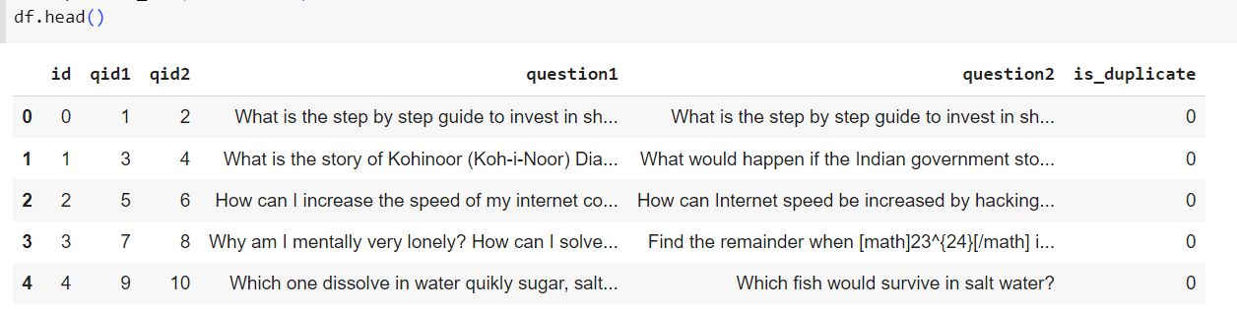
Non Graphical Analysis
Basic overview of dataset

Slide 9
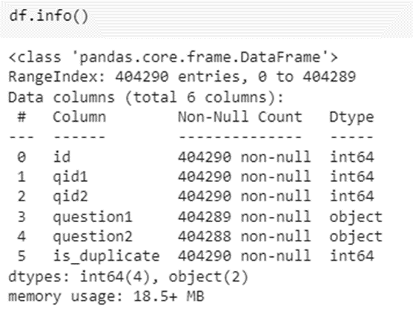
Meta information about dataset
The information contains the number of columns, column labels, column data types, memory usage, range index, and the number of datapoints in each column i.e. non-null values)
Our dataset has 404290 rows and 6 columns.
There is missing values in question1 and question2 columns. There are three null values in our dataset of which one is in question1 and rest two are in question2.

Slide 10
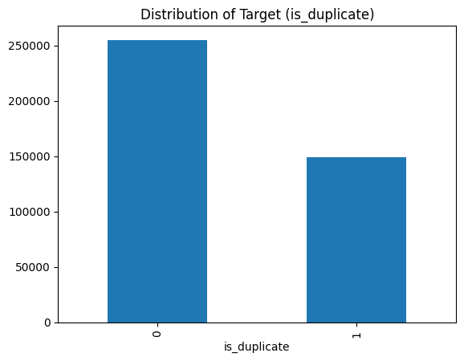
Distribution of data points among is_duplicate (Target column)
Out of 404290 datapoints, we have
No. of non-duplicate data points(0) are 255027 i.e. 63.08 %
No. of duplicate data points(1) are 149263 i.e. 36.92 %
The dataset given is an imbalanced dataset.
The figure represents Bar plot of
Number of duplicate(similar)
and non-duplicate(non similar) questions.

Slide 11
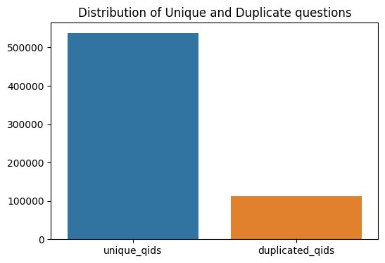
Analysis of qid columns :
Total no. unique and repeated qids are 537933 and 111780 respectively

Slide 12
Data Preprocessing
We have performed the below steps on question1 and question2 columns of the dataset:
Convert entire text to lowercase using “lower() function”.
Replace Special Characters and some numbers with their respective string equivalents using “replace() function”.
Remove Special Characters using “regex”.
Expanding Contractions by first defining them and then replacing it.
Remove html tags using “beautifulsoup”.
Remove Punctuations using “regex”
Remove Stop words using “nltk-stopwords”.

Slide 13
Apply Tokenization using “split() function”.
Apply Stemming using “nltk-PorterStemmer”.
Apply Lemmatization using “nltk-wordnetLemmatizer”.

Slide 14
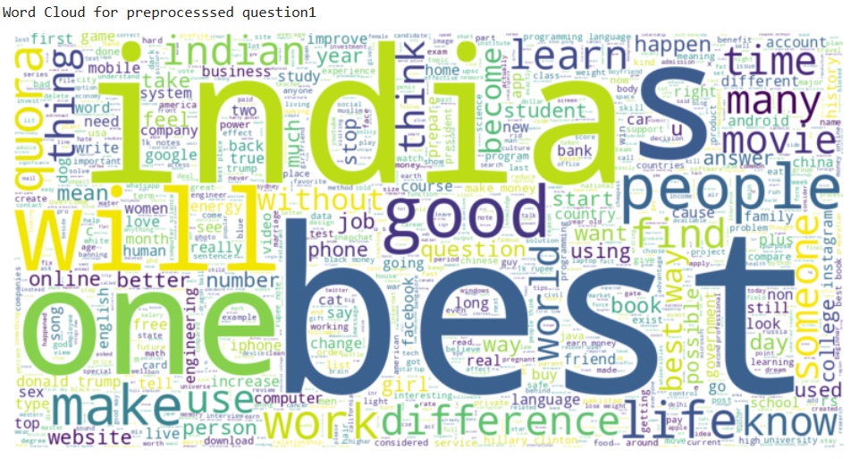
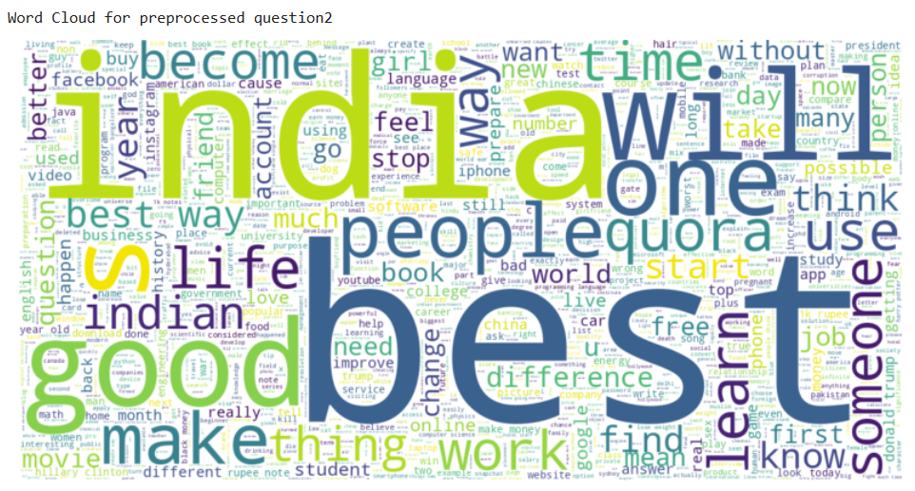
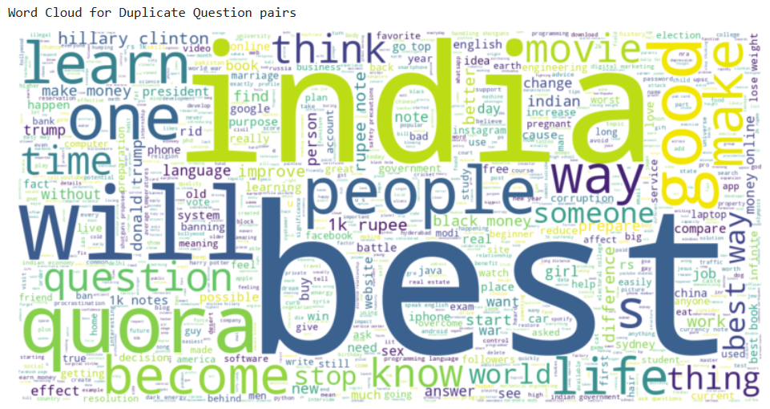
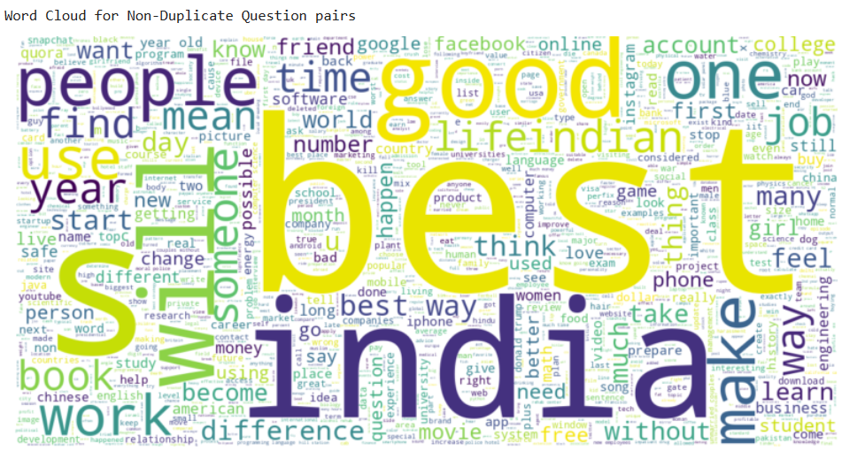
Word Cloud for Preprocessed question1
Word Cloud for Preprocessed question2
Word Clouds
Word Cloud for non duplicate question pairs
Word Cloud for duplicate question pairs

Slide 15
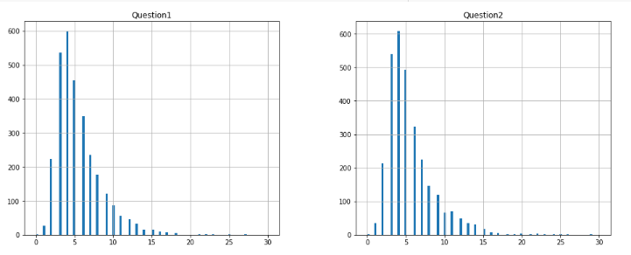
Count Plot of length of words in q1_lem and q2_lem
We can notice that almost 99% of words are in range 0 to 15 for both Question1 and Question2.
And they are very few questions in both Question1 and Question2 that have count of words greater than 15.

Slide 16
Feature Extraction:
Feature extraction refers to the process of transforming raw data into numerical features that can be processed while preserving the information in the original data set. It yields better results than applying machine learning directly to the raw data.
We have divided this step in three parts :
Basic Features : These features are extracted from preprocessed question1 and question2.
Stop Words and Token Features : These features are extracted based on stopwords and tokens from original question1 and question2.
Fuzzy Features : These features are extracted from fuzzywords of preprocessed question1 and question2.

Slide 17
Basic Features
f_q1 = Frequency of qid1’s
f_q2 = Frequency of qid2’s
f(q1+q2) = sum total of frequency of qid1 and qid2
f(q1-q2) = absolute difference of frequency of qid1 and qid2
q1_char = count of characters of Question1
q2_char = count of characters of Question2
q1_num_words = Count of words in Question 1
q2_num_words = Count of words in Question 2
total_word_num = sum of Q1_n_words and Q2_n_words
diff_word_num = absolute difference of Q1_n_words and Q2_n_words
same_first_word = This feature is 1 if both questions have same first word otherwise 0.
same_last_word = This feature is 1 if both questions have same last word otherwise 0.
unique_common_words = Count of unique words which are common for both Question 1 and Question 2
same_common_words = Count of words which are same and common for both Question 1 and Question 2
total_unique_word_share = (unique_common_words)/(total_word_num)
total_same_word_share = (same_common_words)/(unique_common_words)
min_common_word_ratio = Same_common_words divided by minimum number of words between question 1 and question 2.
max_common_word_ratio = Same_common_words divided by maximum number of words between question 1 and question 2.

Slide 18
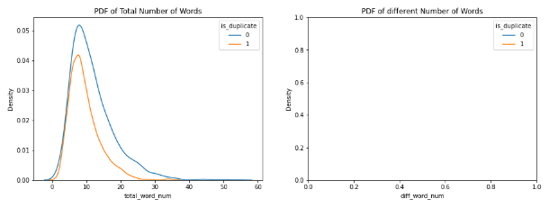
Number of words in question1 for duplicate & non-duplicate question pairs have an overlapping distribution.
Sample data frame doesn’t contains different number of words which suggests that both the features might not be useful for classifying the question pairs to be either duplicate or non-duplicate.

Slide 19
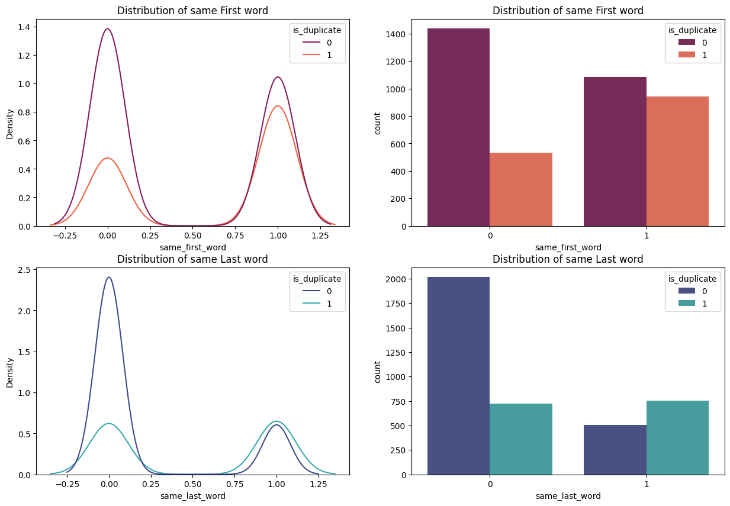
If First word or Last word is the same then there is a high chance that the question pairs are duplicates

Slide 20
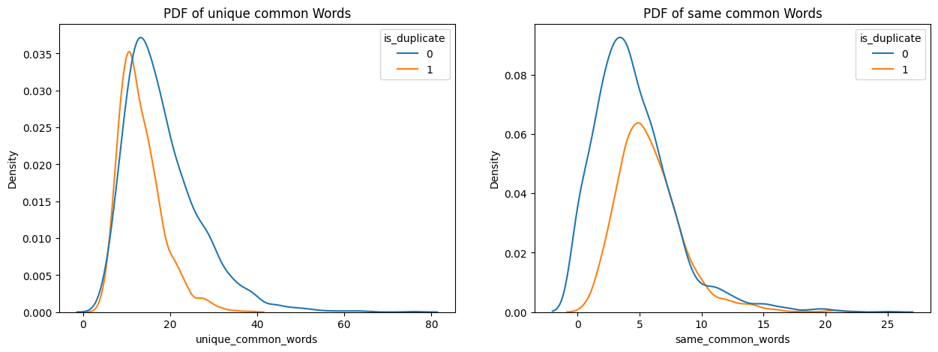

Slide 21
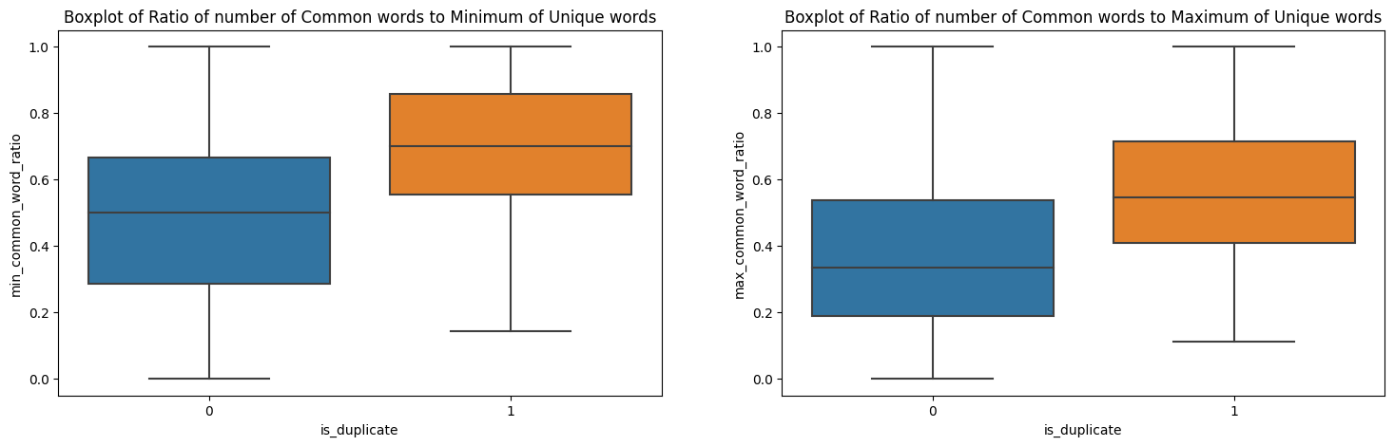

Slide 22
Stop Words and Tokens Features
cwc_min : Ratio of common_word_count to min length of word count of Q1 and Q2
cwc_max : Ratio of common_word_count to max length of word count of Q1 and Q2
csc_min : Ratio of common_stop_count to min length of stop count of Q1 and Q2
csc_max : Ratio of common_stop_count to max length of stop count of Q1 and Q2
ctc_min : Ratio of common_token_count to min length of token count of Q1 and Q2
ctc_max : Ratio of common_token_count to max length of token count of Q1 and Q2
last_word_eq : Check if Last word of both questions is equal or not
first_word_eq : Check if First word of both questions is equal or not
abs_len_diff : Abs. length difference
mean_len : Average Token Length of both questions
longest_substr_ratio : Ratio of length longest common substring to min length of token count of Q1 and Q2

Slide 23
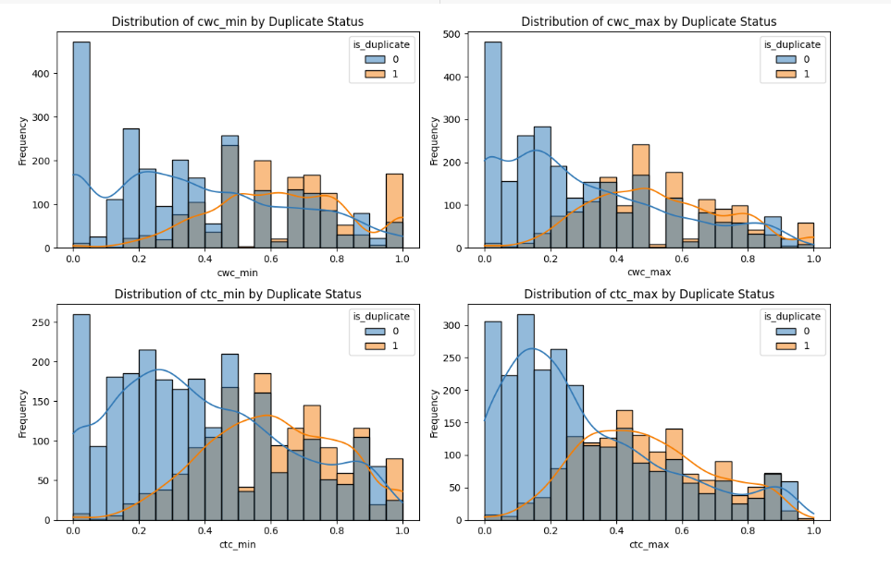
These histograms provide insights into the distribution of the ratios of common non-stopwords and common tokens between question pairs.
The skewness of the distributions suggests that there is a variation in the similarity of non-stopwords and tokens between duplicate and non-duplicate question pairs.

Slide 24
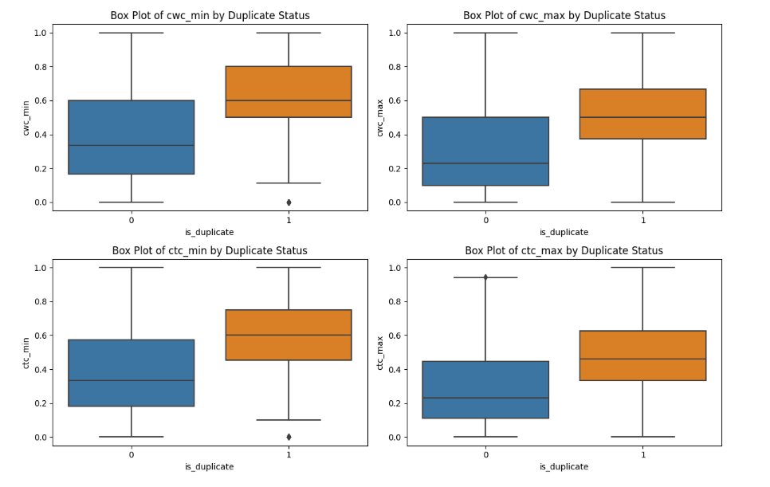
These boxplots provide insights into the distribution and variation of the ratios of common
non-stopwords and common stopwords between duplicate and non-duplicate question pairs.
The differences in the medians suggest that these features can potentially be useful in distinguishing between duplicate and non-duplicate pairs.

Slide 25
Fuzzy Features
fuzz_ratio : fuzzyWuzzy has a ratio function that calculates the standard Levenshtein distance similarity ratio between two sequences.
fuzz_partial_ratio : The partial ratio helps us to perform substring matching. This takes the shortest string and compares it with all the substrings of the same length.
token_set_ratio : Token set ratio performs a set operation that takes out the common tokens instead of just tokenizing the strings, sorting, and then pasting the tokens back together. Extra or same repeated words do not matter.
token_sort_ratio : In token sort ratio, the strings are tokenized and pre-processed by converting to lower case and getting rid of punctuation. The strings are then sorted alphabetically and joined together. Post this, the Levenshtein distance similarity ratio is calculated between the strings.

Slide 26
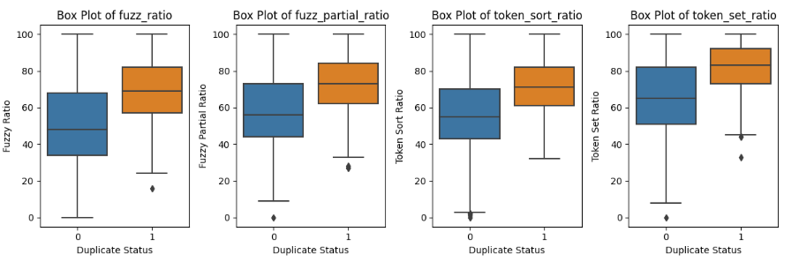
The fuzz ratios tend to be generally higher for duplicate question pairs.
Most of the plots have certain overlapping, but it can somehow work out separability.

Slide 27
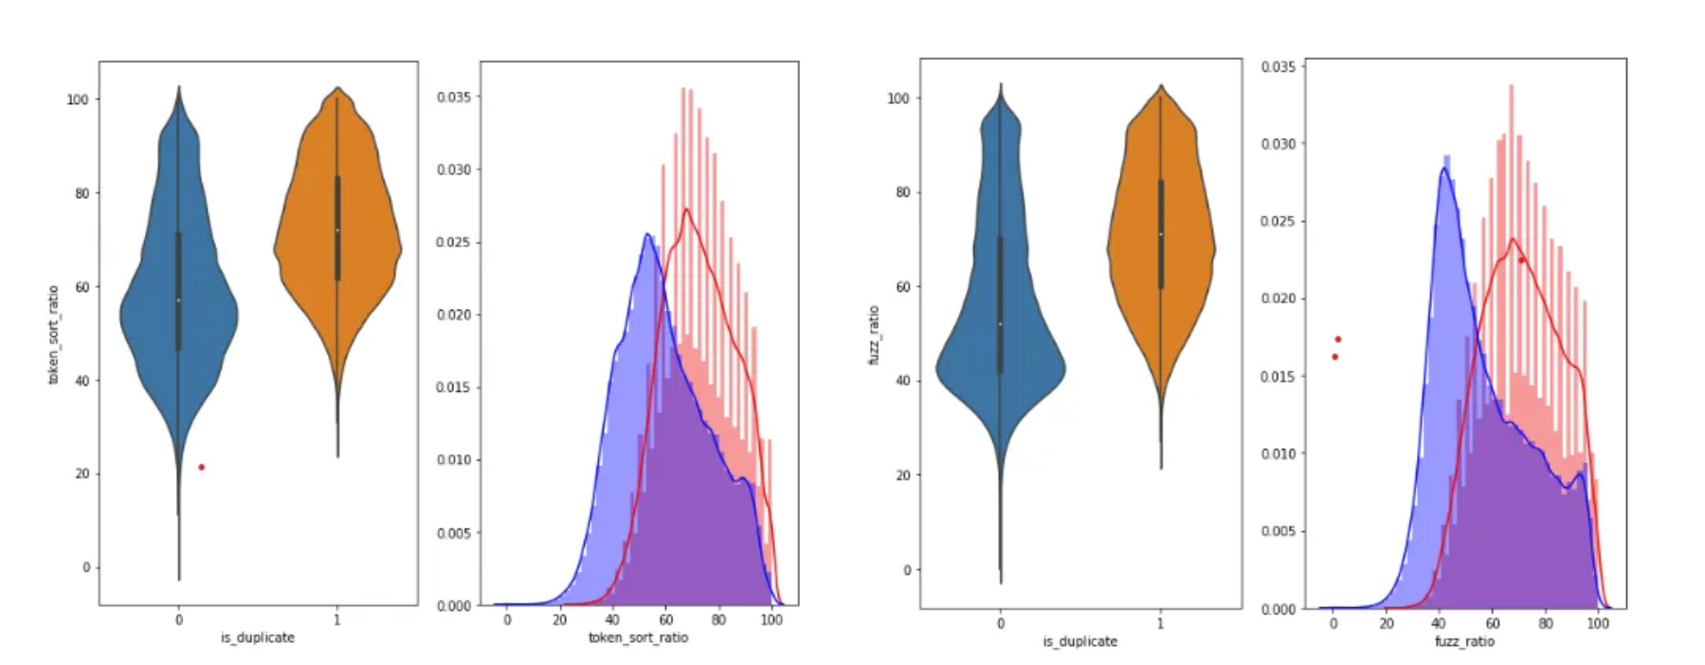
Features like token_sort_ratio and fuzz_ratio also provides some separability as their PDFs have partial overlapping.

Slide 28
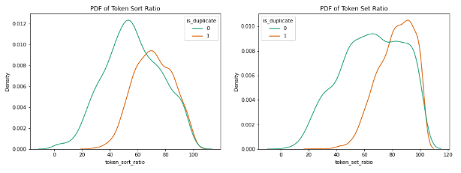
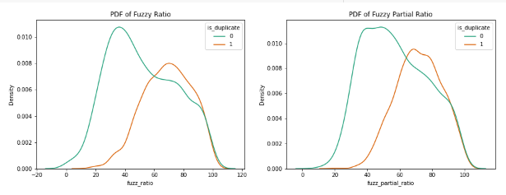
All of these Fuzzy Based Ratios are higher for Duplicate Question Pairs relative to Non-Duplicate Question Pairs

Slide 29
Techniques used for Text to Numerical Vector Conversion
• Bag of Words (BoW)
A simple and efficient method for capturing question pair similarity. However it has limitations in capturing word order, context, and semantic relationships between words.
Word2vec
This approach captures semantic relationships and similarities between words, considering word order and contextual information, thereby addressing some of the limitations of the Bag of Words approach. However, it has limitations in handling contextual ambiguity, domain specificity, and complex relationships.
TF - IDF
This approach is noted for its simplicity and ability to capture term importance. However, it has limitations in handling word order, contextual understanding, and document-level information, which can affect its accuracy in identifying semantic similarities between questions.

Slide 30
Bag Of Words (BoW)
The Bag of Words (BoW) approach involves representing the questions as numerical vectors based on the frequency of occurrence of words in the text.
Vocabulary Creation: Create a vocabulary by collecting unique words from both questions. This will be used as the feature set.
Vectorization: Convert each question into a numerical vector representation using the Bag of Words approach. For each question, count the frequency of each word in the vocabulary and create a vector where each element represents the count of a word in the question.
Similarity Calculation: Calculate the similarity between two question vectors using a similarity metric such as cosine similarity. This will give a similarity score between 0 and 1, where 1 indicates high similarity.

Slide 31
Advantages of the Bag of Words (BoW)
Simplicity
The BoW approach is straightforward to implement and understand, making it an accessible technique for similarity calculations.
Computational Efficiency
BoW vectors are sparse and can be efficiently stored and manipulated, making them suitable for handling large datasets with many features.
Language Independence
BoW representation does not rely on specific language models or pre-trained embeddings, making it applicable to various languages without the need for language-specific resources.
Interpretability
BoW representation provides interpretable results by directly showing the frequency of each word in a question, allowing for easy identification of common and distinctive words.

Slide 32
Disadvantages of the Bag of Words (BoW)
Loss of Word Order and Context
BoW ignores the word order and context in a sentence, treating each word as independent. It fails to capture the semantic relationships between words and may result in loss of important information.
Vocabulary Size
The size of the vocabulary can become large, especially for datasets with a large number of unique words. This can lead to high-dimensional feature vectors, which may affect computational efficiency and increase memory requirements.
Sparsity
BoW vectors are typically sparse, with most elements being zero due to the absence of words in a given question. This sparsity can impact the performance of some similarity metrics and machine learning algorithms.
Stopwords and Irrelevant Words
BoW treats all words equally, including stopwords and other irrelevant words that may not contribute significantly to the semantic meaning of the question. This can dilute the importance of relevant keywords.
Limited Semantic Understanding
BoW does not capture the semantic meaning or similarity between words. It treats different words with the same frequency as equally important, regardless of their actual semantic relatedness.

Slide 33
Word to Vector (W2V)
The Word2Vec (w2v) approach is a popular technique for capturing semantic relationships and similarities between words. It can be utilized to represent questions as dense word embeddings and calculate their similarity based on the embeddings.
The Word2Vec model captures the semantic meaning of words based on their context in the training data.
Sentence Embedding: Calculate sentence embeddings for each question by averaging the word embeddings of all the words in the question. This process captures the semantic representation of the entire question.
Similarity Calculation: Calculate the similarity between two questions using a similarity metric such as cosine similarity. Compute the cosine similarity between the sentence embeddings of the question pair to obtain a similarity score ranging from 0 to 1.

Slide 34
Advantages of the Word2Vec (w2v)
Semantic Understanding
Word2Vec captures semantic relationships between words, allowing it to understand and represent the meaning of words based on their context. This enables it to capture more nuanced similarities between questions compared to traditional methods like Bag of Words.
Word Order and Context
Word2Vec considers the sequential order of words and their context within a sentence, providing a better representation of the overall meaning of a question pair. It can capture the similarity between questions even if they have different word choices but convey the same intent.
Dense Vector Representations
Word2Vec produces dense word embeddings, which encode semantic information in lower-dimensional vectors. These embeddings allow for efficient representation of questions and similarity calculations, especially when dealing with large datasets.
Out-of-Vocabulary Handling
Word2Vec can generalize to some extent for out-of-vocabulary words based on their context and similarity to known words. It can generate meaningful representations for unseen words based on the learned embeddings, which is useful for handling misspellings or rare words.

Slide 35
Disadvantages of the Word2Vec (w2v)
Data Dependency
Word2Vec relies on large amounts of text data for training meaningful word embeddings. If the available dataset is small or not representative of the target domain, the quality of the embeddings may be compromised.
Contextual Ambiguity
Word2Vec may struggle with capturing nuanced contextual differences and resolving ambiguous phrases. It treats each word as an atomic unit, which can limit its ability to differentiate between questions with similar words but different meanings.
Limited Understanding of Complex Relationships
Word2Vec may struggle with capturing complex relationships between words, such as negation or more abstract concepts. It primarily focuses on local word-context patterns and may not grasp higher-level semantic associations or global dependencies.
Lack of Multi-word Expression Understanding
Word2Vec typically treats multi-word expressions as separate individual words, which can limit its ability to capture the full meaning of phrases or idiomatic expressions.
Vocabulary Coverage
Word2Vec relies on a fixed vocabulary, and out-of-vocabulary words may pose challenges. Uncommon or domain-specific terms that are not present in the training corpus may not have meaningful embeddings, potentially affecting similarity calculations.

Slide 36
TF – IDF approach
TF-IDF (Term Frequency-Inverse Document Frequency) involves representing questions as vectors based on the frequency of terms in each question and their importance in the entire question pairs dataset.
TF-IDF Vectorization: Calculate the TF-IDF weights for each word in the question pairs dataset. TF-IDF assigns higher weights to terms that appear frequently in a specific question but are rare in the overall dataset, indicating their importance in distinguishing the question pair.
Vector Representation: Represent each question as a TF-IDF weighted vector. Each question will be transformed into a vector where each element corresponds to the TF-IDF weight of a specific term.
Similarity Calculation: Compute the similarity between two questions using a similarity metric such as cosine similarity. Calculate the cosine similarity between the TF-IDF vectors of the question pair to obtain a similarity score ranging from 0 to 1.

Slide 37
Advantages of TF-IDF
Simple and interpretable
TF-IDF is a straightforward and easy-to-understand approach. It assigns weights to words based on their importance in the document and their frequency in the entire corpus. This makes it interpretable and allows for a clear understanding of how the similarity score is computed.
Captures term importance
TF-IDF considers both term frequency (TF) and inverse document frequency (IDF). By weighing terms based on their importance, it can identify and prioritize significant words that contribute more to the meaning of the question. This helps in capturing the essence of the questions and identifying similarities based on important terms.
Handles common and rare words well
TF-IDF handles common words (e.g., "the," "is") by assigning them lower weights, as they tend to occur frequently across all documents. On the other hand, it assigns higher weights to rare words, which are likely to be more informative. This helps in distinguishing meaningful terms and reducing the impact of common words.

Slide 38
Disadvantages of TF-IDF
Ignores word order and context
TF-IDF does not consider the order of words or the context in which they appear within the question. It treats each term independently and computes the similarity based on their individual importance. As a result, the model might overlook the semantic meaning and context of the questions, leading to inaccurate similarity scores.
Limited semantic understanding
TF-IDF is a statistical approach and does not inherently understand the meaning of words or phrases. It relies solely on the frequency and importance of terms. This can be limiting when dealing with questions that have different phrasing but convey the same underlying meaning. TF-IDF might not capture these subtle semantic nuances effectively.
Lack of document-level information
TF-IDF focuses on the importance of terms within individual documents. It does not consider the broader context or the relationship between multiple terms within a document. This can lead to a limited understanding of the overall content and potentially miss important connections between terms in different questions.

Slide 39
Advanced Techniques for Numerical to Vector Conversion
GloVe (Global Vectors for Word Representation)
Word embeddings
GloVe generates word embeddings that capture semantic relationships between words. These embeddings are pre-trained on a large corpus of text and can be used to represent words as dense vector representations. By comparing the embeddings of words in question pairs, GloVe can measure the similarity between questions based on their semantic meaning.
Fixed-length representations
GloVe represents each word with a fixed-length vector. To compare two questions, additional techniques like averaging or pooling the word embeddings are typically used to create a fixed-length representation for each question. Similarity measures like cosine similarity or Euclidean distance can then be applied to these representations.
Contextual information
GloVe embeddings do not inherently capture contextual information about words in a specific sentence. The representations are based on word co-occurrence statistics from the training corpus. Therefore, GloVe might struggle to capture the full semantic meaning of a question pair, especially when the meaning depends on the specific context in which the words are used.

Slide 40
BERT (Bidirectional Encoder Representations from Transformers)
Transformer-based architecture
BERT is a transformer-based model that is pre-trained on a large corpus of text using masked language modeling and next sentence prediction tasks. This allows BERT to capture both local and global contextual information, resulting in more accurate and contextualized representations of words and sentences.
Fine-tuning
After pre-training, BERT can be fine-tuned on specific downstream tasks, such as question pair similarity. During fine-tuning, BERT learns to adapt its representations to the specific task, enabling it to better capture the semantic meaning and similarity between question pairs.
Sentence-level embeddings
Unlike GloVe, BERT provides contextualized word embeddings at the sentence level. It takes into account the entire sentence and the relationship between words to generate embeddings. By feeding the question pairs through BERT and extracting sentence-level representations, more accurate similarity scores can be obtained.
State-of-the-art performance
BERT has achieved state-of-the-art performance on various natural language processing tasks, including question pair similarity. Its ability to capture contextual information and semantic relationships between words makes it a powerful tool for understanding the meaning and similarity of questions.

Slide 41
Model Building using Classification Algorithms
Model Building is the process of developing a Probabilistic Model that best describes the relationship between the dependent and independent variables.
Building an ML Model requires splitting of data into two sets, such as ‘training set’ and ‘testing set’ in the ratio of 80:20 or 70:30; A set of supervised (for labelled data) and unsupervised (for unlabeled data) algorithms are available to choose from depending on the nature of input data and business outcome to predict.
We have chosen the following four algorithms for creating the model
* Logistic Regression * SVM Classifier
* Random Forest * XGBoost

Slide 42
Model Evaluation
Model evaluation is the process of using different evaluation metrics to understand a machine learning model's performance, as well as its strengths and weaknesses. Model evaluation is important to assess the efficacy of a model during initial research phases, and it also plays a role in model monitoring.
There are several metrics to be considered while choosing a Particular Model , like Classification Report (measures the performance of our Machine Learning classification model, using Accuracy , Precision , Recall , F1 Score) and Confusion Matrix (measures an estimation between Actual and Predicted Values).

Slide 43
Evaluation Metrics
Confusion Matrix
A table that allows visualization and evaluation of the performance of a classification model. It is especially useful when working with supervised learning algorithms that are designed to classify instances into different classes or categories.
A confusion matrix displays the true positive (TP), true negative (TN), false positive (FP), and false negative (FN) values. These values represent the number of instances that were correctly or incorrectly classified by the model.
Here is a breakdown of the components of a confusion matrix:
• True Positive (TP): The number of instances that are correctly predicted as positive by the model.
• True Negative (TN): The number of instances that are correctly predicted as negative by the model.
• False Positive (FP): The number of instances that are incorrectly predicted as positive by the model (Type I error)
• False Negative (FN): The number of instances that are incorrectly predicted as negative by the model (Type II error)
The confusion matrix is typically represented as a 2x2 matrix for binary classification problems.

Slide 44
Classification Report
A classification report is a performance evaluation tool that provides a detailed summary of the performance of a classification model. It is commonly used to assess the quality and effectiveness of a classifier algorithm.
Here's a brief explanation of the key metrics in a classification report:
• Precision: It measures the accuracy of positive predictions. It is calculated as the ratio of true positives to the sum of true positives and false positives. Precision indicates how many of the samples predicted as positive are actually true positives.
• Recall: It measures the ability of the classifier to find all the positive samples. It is calculated as the ratio of true positives to the sum of true positives and false negatives. Recall indicates how many of the actual positive samples were correctly predicted.
• F1-score: It is the harmonic mean of precision and recall. It provides a balanced measure of the classifier's performance by considering both precision and recall. The F1-score is often used as a single metric to evaluate the classifier's overall performance.
• Support: It represents the number of samples of the true response in the test set. It gives an idea of the distribution of the classes in the test dataset.

Slide 45
Experiment Tracking with MLFlow
MLFlow helps you to organize your experiments into runs.
By automating the entire ML model life cycle from integration to deployment to monitoring, MLOps enables faster and more reliable delivery of machine learning models. In addition, MLOps can help organizations track and audit the changes made to models and improve model management.
MLOps can help organizations improve the quality of their machine learning models and speed up the development process
MLOps can help to reduce the risks associated with machine learning development and deployment. By automating the ML model life cycle, MLOps can help to improve the accuracy of machine learning models and make the development process more efficient.

Slide 46


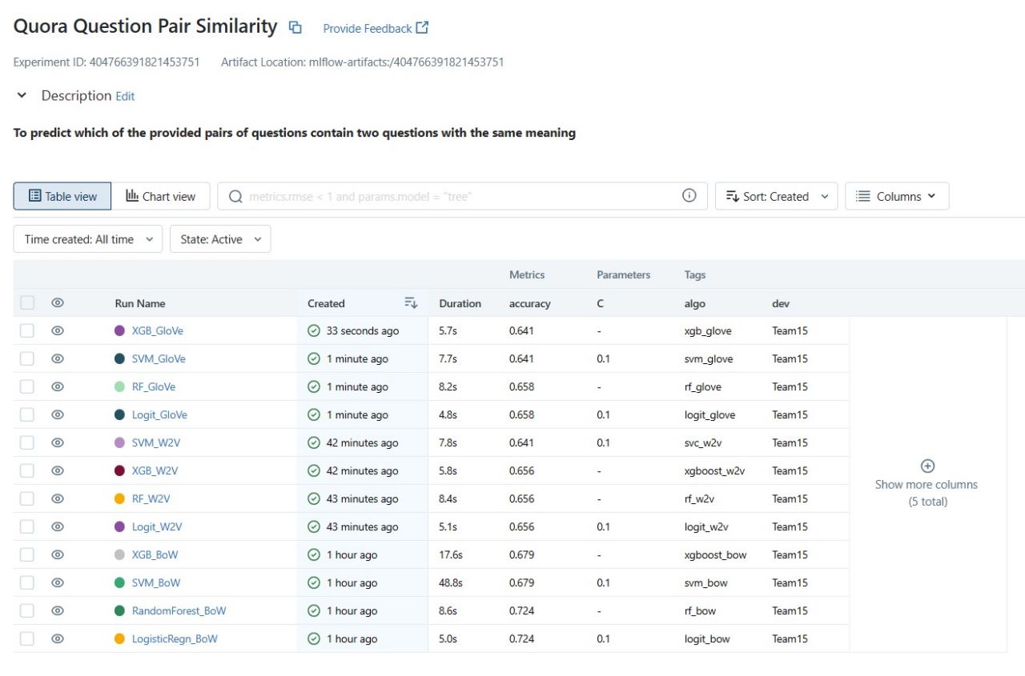



MLFLOW

Slide 47
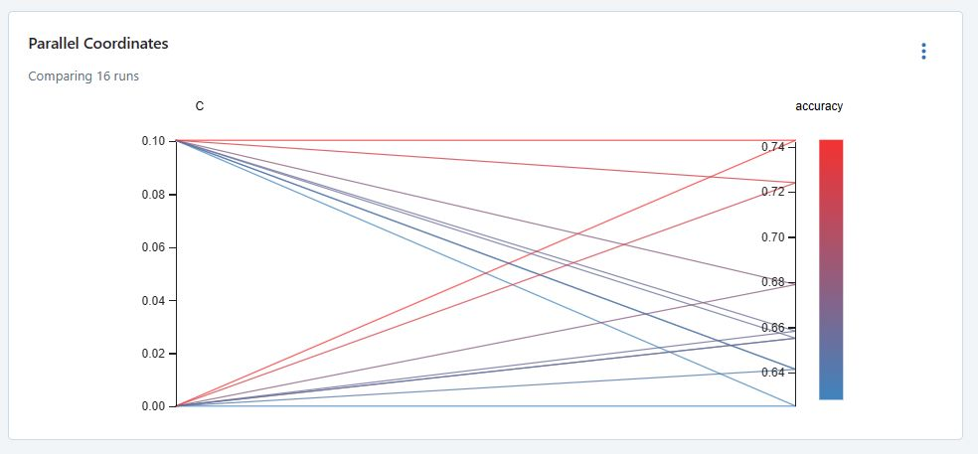

Slide 48
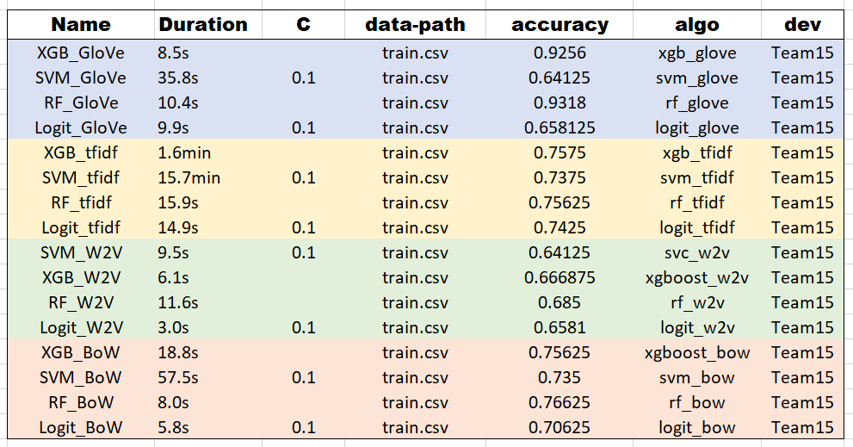
Experiment Tracking Results

Slide 49
Conclusion
After successful creation of various models using various text to numerical conversion techniques, we observed that the Random Forest algorithm and the XGBoost algorithm were the only ones who were able to perform better than the other two algorithms.
Out of all the text to numerical conversion techniques, the Glove approach worked better than the other approaches as Random Forest and XGBoost algorithm had an accuracy of 93.8% and 94.1% respectively.
This type of problems require huge amount of data for training.

Slide 50
Future Scope
Improving the accuracy of the model using deep learning algorithms.
Creating a UI using tools like Streamlit or Flask and make a user friendly experience.
Deploying the model on cloud and increasing the number of users of the app.

Slide 51
Thank You

